Slide 1
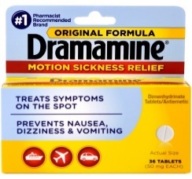
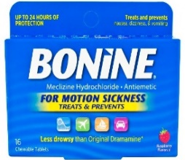
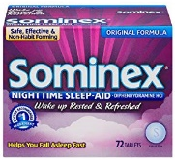
Your Current Medications and Brain Health
Some prescription medications, over-the-counter-medications, and herbal supplements can cause memory problems and confusion.
Bring ALL medications that you take to your appointment before surgery (prescription medications, over-the-counter medications, and herbal supplements). Your doctor will review them and tell you how to use your medications before and after surgery.
You should avoid these drugs before surgery. Talk to you doctor about how to stop or reduce their use.
 | Common Sleep Aids | Allergy Medicines | Motion Sickness Medicines
Ingredients to Avoid | diphenhydramine or doxylamine | chloropheniramine | dimenhyrinate or meclazine
Example Drugs
 | Belladonna | Valerian Root | Marijuana | Alcohol
Prescription Drugs | Nausea / Motion Sickness | Severe Diarrhea | Muscle Relaxants | Antidepressants / Migraine
 | Scopolamine Prochlorperazine (Compazine) Promethazine (Phenargen) | Lamotil | Cyclobenzaprine (Flexeril) Carisoprodol (Soma) Methocarbamol (Robaxin) | Amitriptyline Nortriptyline Imipramine Doxepin Desipramine Paxil
 | Irritable Bowel Syndrome | Anti-Anxiety | Urinary Incontinence | Insomnia / Sleep Aids
 | Atropine Belladonna Dicyclomine (Bentyl) Hyoscyamine (Levsin) | Alprazolam (Xanax) Lorazepam (Ativan) Clonazepam (Klonopin) Diazepam (Valium) | Oxybutinin (Ditropan) Tolteradine (Detrol) Solifenacin (Vesicare) | Zolpidem (Ambien) Eszopiclone (Lunesta) Zaleplon (Sonata)

