Slide 1
Executive Overview

Slide 2
The Perioperative Surgical Home (PSH)
The PSH is a patient-centered, physician-led, interdisciplinary, and team-based system of coordinated care.
It spans the entire surgical episode from the decision of the need for an invasive procedure – surgical, diagnostic, or therapeutic – to discharge and beyond.

Slide 3
A Coordinated System of Perioperative Care

Slide 4
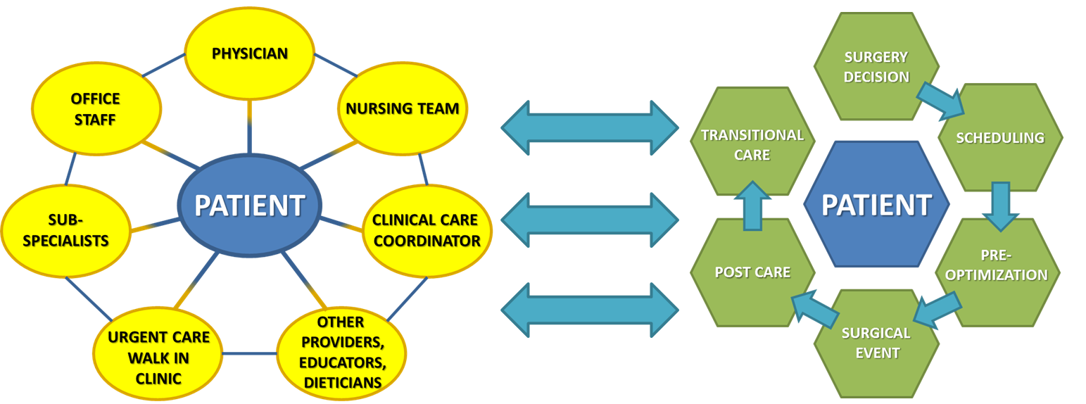
Creating a Seamless System of Team-Based Care
Patient Centered Medical Home
Perioperative Surgical Home

Slide 5
Aligned with the Ongoing Shift from Volume to Value
The PSH is a care delivery model with outcomes that are aligned with the goals of a variety of value-based payment models, including:
CMS’ Bundled Payment for Care Improvement (BPCI) Program
CMS’ Comprehensive Care for Joint Replacement (CJR) Program
CMS’ Medicare Shared Savings Program (MSSP)
CMS’ proposed Episode Payment Model (EPM) program
Medicaid Bundled Payment Programs
Commercial Accountable Care Organizations (ACOs)
Commercial Bundled Payment Programs

Slide 6
Facilitating Successful Transformation
Implementing a PSH can be challenging without adequate preparation, resources, and support
The PSH Consult identifies existing organizational strengths to leverage and opportunities for further development as your team prepares to plan, launch, enhance, and/or expand your PSH initiatives

Slide 7
The PSH Consult Process
Pre-Assessment Webinar
An introduction to the PSH (e.g., basic framework and rationale)
PSH in the context of ongoing national trends in PHM and value-based care
An overview of the assessment process and expected outcomes
Assessment Tool
Current organizational knowledge of key PSH principles
Current organizational capabilities for PSH core competencies
Key opportunities for improvement and further development
Assessment Support
(if needed)
General questions that arise while completing the assessment
Clarification regarding specific questions and/or response options
Technical issues pertaining to the assessment tool or online platform
Post-Assessment Webinar & Report
General findings and overall results of the assessment
Organizational strengths and opportunities for improvement
Summary report and recommended next steps and key resources
Evaluation & CME
Feedback for the ASA/Premier assessment team
Survey to secure CME credits (if applicable)

Slide 8
Accessing Materials & Securing CME Credit
All of the materials and resources included in the PSH Consult are available online through the ASA’s education center, accessible at:
https://education.asahq.org
All members of your team will have access to this interactive site
Up to 5 hours of CME credits are available to providers participating in the PSH Consult process

Slide 9
Thank you.
For additional information, please visit:
http://www.asahq.org/psh/pshconsult
If you have further questions, please contact:
PSHConsult@asahq.org

