Slide 1
The Perioperative Surgical Home
Total Joint and Knee Replacement Program
Michael Schmidt, DO
Staff Surgeon, Mid-Michigan Orthopedics,
Chairman, Department of Surgery, Memorial Healthcare
Joe Kochan, MD
Chairman of Anesthesiology, Director of Perioperative Services
Kathy Roberts, RN
Director of Patient Care Services
Jonathan Friedman, MBA, CPC,
CEO and President, PRN Advisors LLC

Slide 2
Learning Objectives
Categorize the key metrics needed to analyze new opportunities within current facilities
Design and discover relevant opportunities to be presented to the group
Create shared decision making for all partners when services are being identified

Slide 3
Alternative Payment Methods (APM)
Total Knee and Hip Replacements
Hospitals will be financially responsible for all aspects of care from admission until 90 days after discharge.
Episode-based Payment Initiatives, Section 3021 of the
Affordable Care Act

Slide 4
Alternative Payment Methods (APM)
Be prepared to enter into three kinds of at risk contracts:
Pay for Performance – Providers receive incentives for meeting quality targets
Shared Savings Contracts – Payers share with providers the cost savings achieved through value-based approaches to care
Bundled Payments – Healthcare facilities and providers agree to a single payment for all care and service associate with a specific condition or treatment
Wagner K. Healthcare Executive May/June 2015: pp 11-18

Slide 5
The Institution’s Goals
TRIPLE AIM
Improving the patient experience of care (including quality and satisfaction)
Improving the health of populations; and
Reducing the per capita cost of health care.

Slide 6
Silos of Care in Surgical Care Process
PERIOPERATIVE SURGICAL HOME
Preoperative Phase
Perioperative Phase
Postoperative Phase
Discharge and Transition

Slide 7
The Perioperative Surgical Home
“A patient-centered and physician-led multidisciplinary team-based system of coordinated care that guides the patient throughout the entire surgical experience.”
Marc Warner, MD, Mayo Clinic College of Medicine, Rochester, MN
Preoperative
Intraoperative
Postoperative
Post Discharge

Slide 8
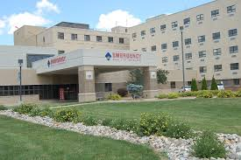
Memorial Healthcare
150-bed community hospital
Serves the greater Shiawassee County area in Michigan
Operates over 25 satellite offices locations
Annually services 28,000 emergency patients, 200,000 outpatients and 3,800 inpatients

Slide 9
Begin with the End in Mind
Length of Stay (LOS)
Patient Satisfaction (Press Ganey Scores)
Readmission Rates
Infection Rates
Cancellations
Delays
Cost Reduction
Discharge Destination (Home, SNF)
Marketing

Slide 10
10
Who are the Stakeholders?
Finance
Physicians
C-Suite
Nursing
Nutrition
Case Management
Physical Therapy
Blood Bank
Marketing
Quality Improvement
Occupational Therapy
Surgical Technicians
Pharmacy
IT/Informatics
Other Organizations (Marcqi, Aspire)
Notes:
More detail on how this worked?

Slide 11
Find a Champion Michael Schmidt, DO
Staff Surgeon, Mid-Michigan Orthopedics
Chairman, Department of Surgery, Memorial Healthcare
Member of Memorial Healthcare Board of Board of Trustees

Slide 12
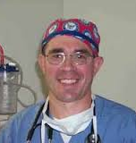
Find a Champion Joseph Kochan III, MD
Chairman of Anesthesiology, Memorial Healthcare
Member of Board of Directors of Physician Anesthesia Service
Director of Perioperative Services, Memorial Healthcare

Slide 13
13
The Perioperative Surgical Home Steering Committee
Orthopedic Surgeon
Chairman of Anesthesia
Chief Nursing Officer
VP of Performance Improvement and Quality
Director of Patient Care Services
Notes:
More detail on how this worked?

Slide 14
14
The Perioperative Surgical Home Steering Committee
Decision Making Authority and Accountability
Oversees work group
Meets once a month
Makes decisions based on work group recommendations
Clarifies questions and issues presented by work group
Review and accountable for outcomes
Notes:
More detail on how this worked?

Slide 15
Start with the Small Wins
Elimination of unnecessary tests (Chest x-rays and EKGs)
Assessment of patient environment preoperatively
Anesthesiologists ordering and evaluating all tests
Evaluating patients two weeks prior to surgery

Slide 16
16
The Perioperative Surgical Home Work Group
Perioperative Nursing
Pharmacy
Patient Care Services
Anesthesiologist
Technicians
Care Manager
Physical Therapy
Occupational Therapy
Dietary
Surgical Office Manager
Project Manager
Performance Improvement and Quality
IT/Informatics
Notes:
More detail on how this worked?

Slide 17
17
Work Group
Build Consensus and Standardization
Working group reviews literature and adopts care protocols
Meets every two weeks
Team reviews value stream map (LEAN Six Sigma) to ensure pathway efficiency
Team reports up to the Steering Committee

Slide 18
Value Stream Mapping Analyze the Current State

Slide 19
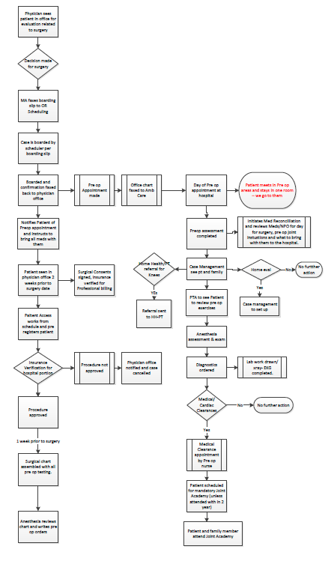
Value Stream Mapping Develop the Future State

Slide 20
20
Modification to the Pre-Op Process
Existing Preoperative Process
New Joint Surgical Home Pre-op Clinic
Tests performed on all patients (e.g. -Chest X-rays and EKGs ordered for all patients)
No standard protocol for pre-op evaluation
Anesthesiologist performs evaluation day of surgery
Education of patient once a month at Joint Camp
No standardized protocol for medication
Home evaluation limited
Anesthesiologist orders tests in accordance with protocol
Pre-op evaluation and exam performed by anesthesiologist two weeks prior to surgery
PT/OT evaluation and education two weeks prior to surgery
Bactroban ointment intranasal, ASA therapy, Tranexamic acid, Celebrex, Gabapentin, Norco, Acetaminophen and antibiotic based on weight
Standardized home visits with questionnaire

Slide 21
21
Perioperative Process
Foley catheter usage decreased
Eliminated use of Duramorph spinals
Tranexamic acid at incision
Decadron pre-op in non diabetic patients
Use of long-acting local anesthesia
Improved multimodal pain management
Prevention of blood loss
Standardization of guidelines and protocols
Notes:
Greater infection rates if use foley catheter

Slide 22
22
Postoperative Process
Discharge of most patients on POD 2
Dietary screening – low fat and high protein diet
Emphasis on p.o. analgesia–use of parenteral narcotics limited to use for break-through pain
Tranexamic acid post-op
Decadron post-op in non diabetic patients
Improved multimodal pain management
Prevention of blood loss
Standardization of guidelines and protocols
Notes:
Greater infection rates if use foley catheter

Slide 23
Timeline
July 2015: 1st Meetings of Steering Committee and
Work Group
October 2015: Preparation of Pre-op Clinic
November 2015: Soft Launch of PSH
December 2015: All Patients for Total Hips and Knees go through PSH
January 2016: Completion of PSH and Data Collection

Slide 24
Patient Satisfaction Ratings Press Ganey

Slide 25
Patient Satisfaction Ratings Press Ganey

Slide 26
Patient Satisfaction Ratings Press Ganey

Slide 27
Patient Satisfaction Ratings Press Ganey

Slide 28
Patient Satisfaction Ratings Press Ganey

Slide 29
Patient Satisfaction Ratings Press Ganey

Slide 30
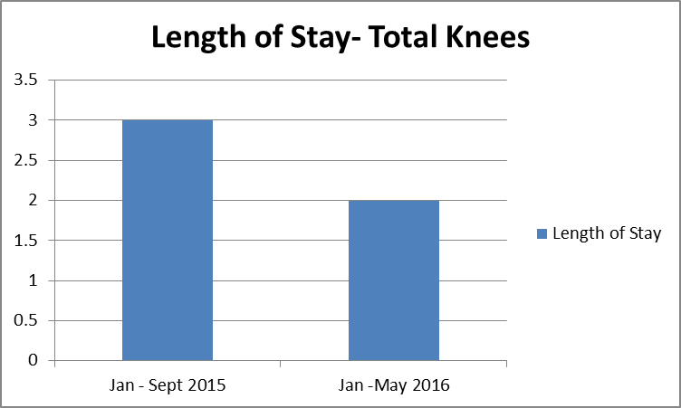
Length of Stay Total Knees

Slide 31
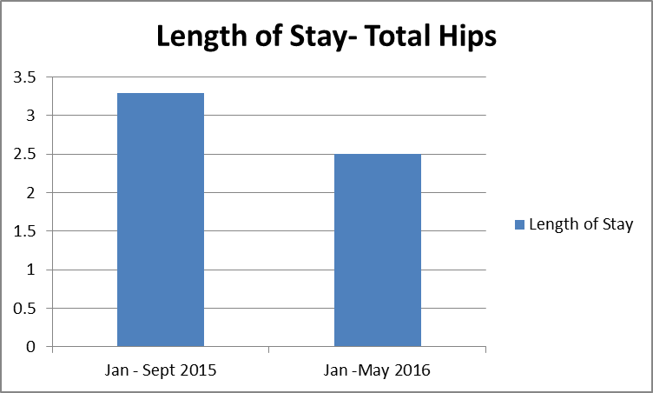
Length of Stay Total Hips

Slide 32
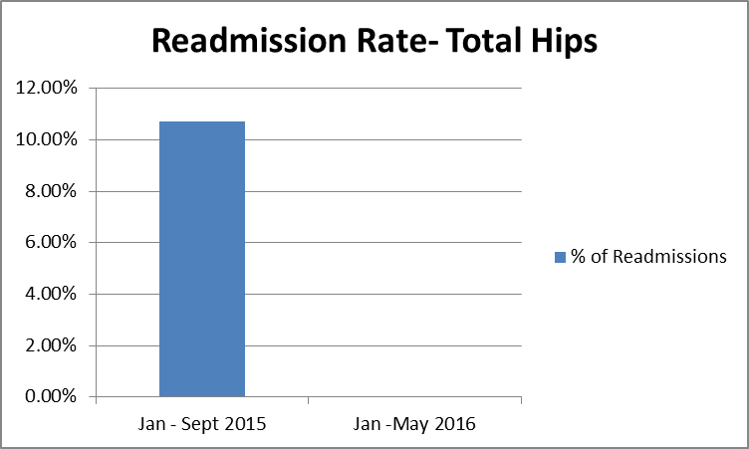
Readmission Rate Total Hips

Slide 33
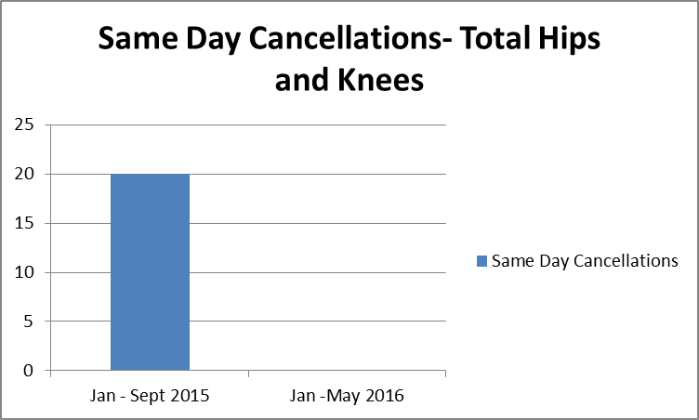
Same Day Cancellations Total Hips and Knees

Slide 34
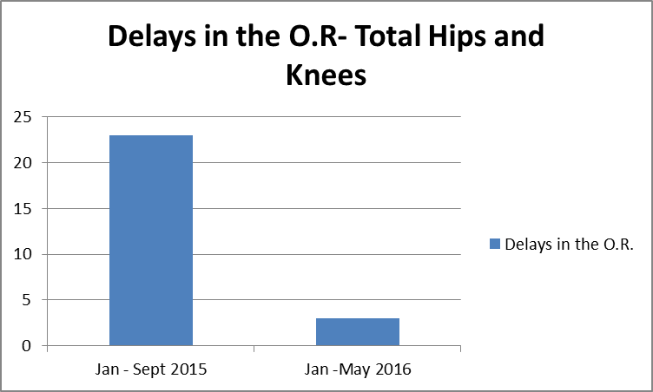
Delays in the O.R. Total Hips and Knees

Slide 35
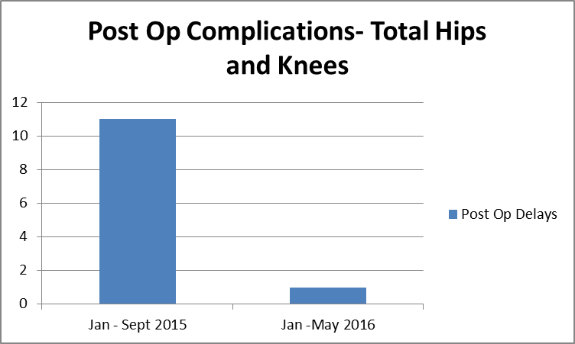
Post Op Complications Total Hips and Knees

Slide 36
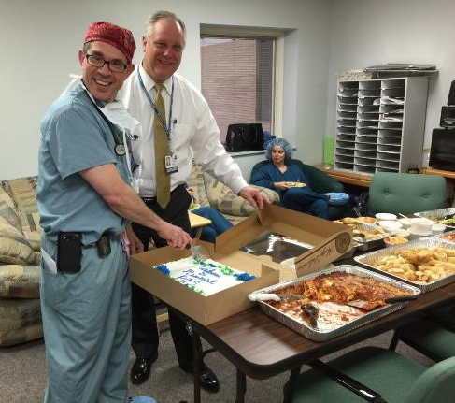
Celebrate the Successes and Repeat!

